Slide 1


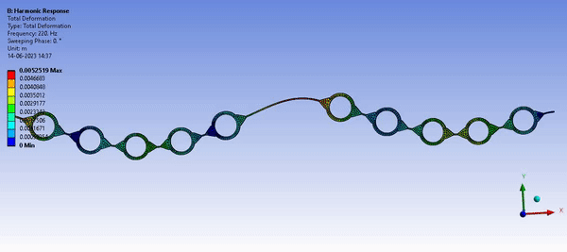


Meta Fluidic Vortex Induced Vibration
Energy Harvester
By:
Shivansh Pandey
for the fulfilment of requirement of Summer Internship 2023
Principal Investigator:
Dr. Bishakh Bhattacharya HAL Chair Professor, ME-IITK
Mentors: Dr. Manas Ranjan Behera
Vivek Gupta
Ashish Shukla
Smart Materials, Structures and Systems (SMSS) Laboratory
Department of Mechanical Engineering, IIT Kanpur
https://www.iitk.ac.in/smss/
Date: 20 June 2023

Slide 2

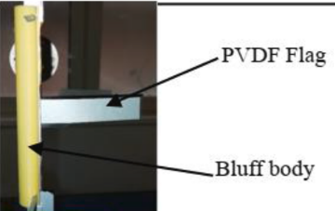
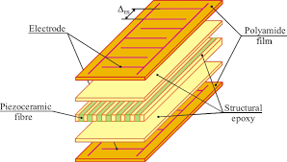
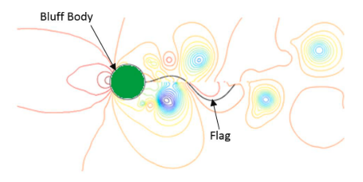
Introduction
MFC 2814 P1
Kovalovs, A., Barkanov, E., & Gluhihs, S. (2007). Active control of structures using macro-fiber composite (MFC). Journal of Physics: Conference Series, 93(1). https://doi.org/10.1088/1742-6596/93/1/012034
Mehdipour, I., Madaro, F., Rizzi, F., & De Vittorio, M. (2022). Comprehensive experimental study on bluff body shapes for vortex-induced vibration piezoelectric energy harvesting mechanisms. Energy Conversion and Management: X, 13. https://doi.org/10.1016/j.ecmx.2021.100174
Park, H. W., Seung, H. M., Choi, W., Kim, M., & Oh, J. H. (2022). Highly tunable low frequency metamaterial cavity for vibration localization. Scientific Reports, 12(1), 1–11. https://doi.org/10.1038/s41598-022-13453-1

Slide 3
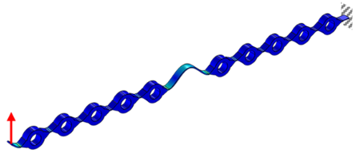
Objective
To examine the effect of the design and properties of the meta-beam, which is connected to the bluff body, on the oscillation amplitude of a flow-induced vibration system.
To match interface mode frequency with the shedding frequency of the vortices to get lock in phenomena.
Park, H. W., Seung, H. M., Choi, W., Kim, M., & Oh, J. H. (2022). Highly tunable low frequency metamaterial cavity for vibration localization. Scientific Reports, 12(1), 1–11. https://doi.org/10.1038/s41598-022-13453-1

Slide 4
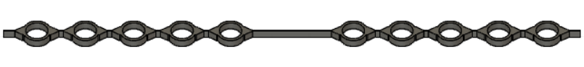
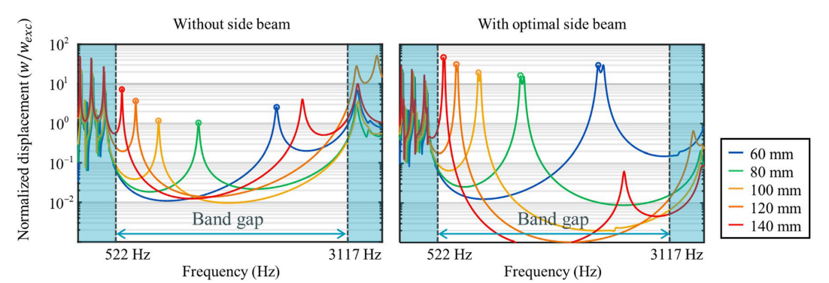
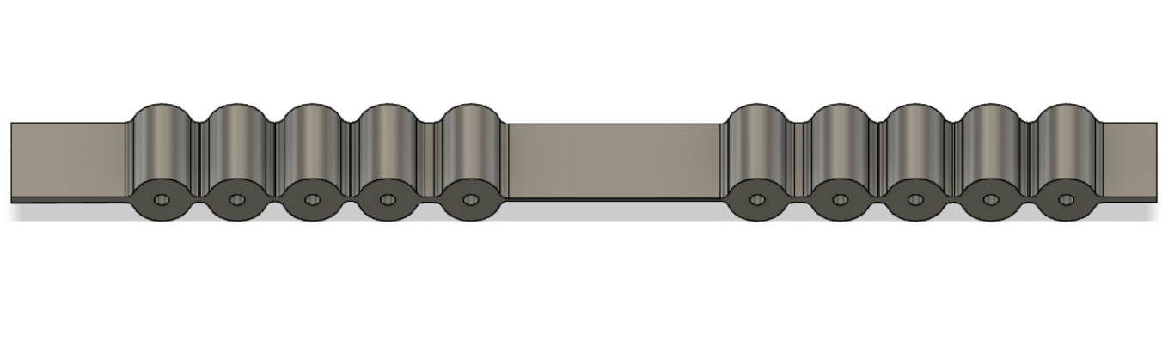
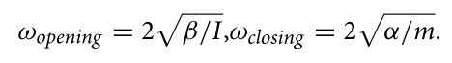
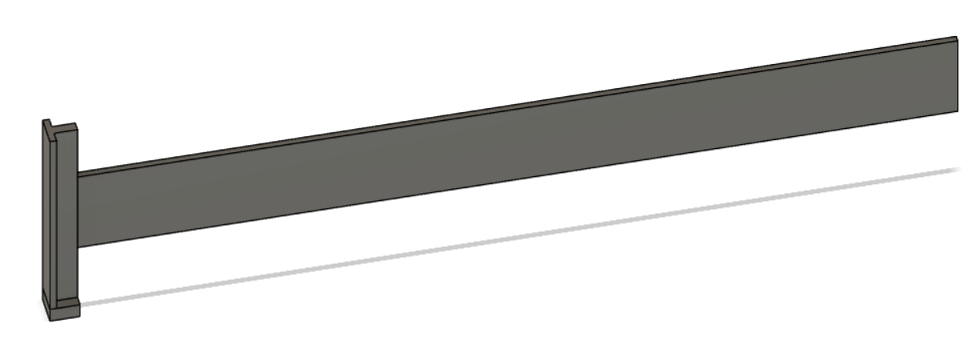
Meta-Beam Designs
Park et. (2022) [1]
rotational inertia I mass m
bending stiffness β shear stiffness α
Meta-material beam
Length: 200mm Thickness: 1mm
Different variations-
Inserts of stainless steel
Increasing cavity length
Increasing cavity thickness
Compared with normal beam
Normal Beam
Length: 200mm, Thickness: 1.5mm
Park, H. W., Seung, H. M., Choi, W., Kim, M., & Oh, J. H. (2022). Highly tunable low frequency metamaterial cavity for vibration localization. Scientific Reports, 12(1), 1–11. https://doi.org/10.1038/s41598-022-13453-1

Slide 5
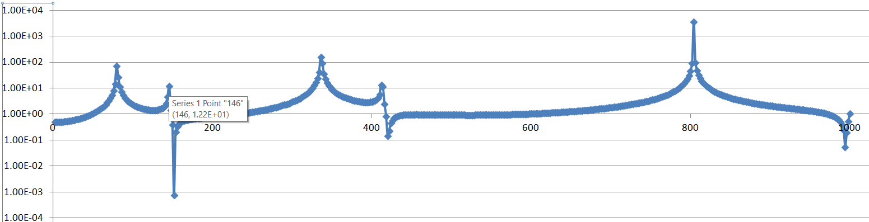
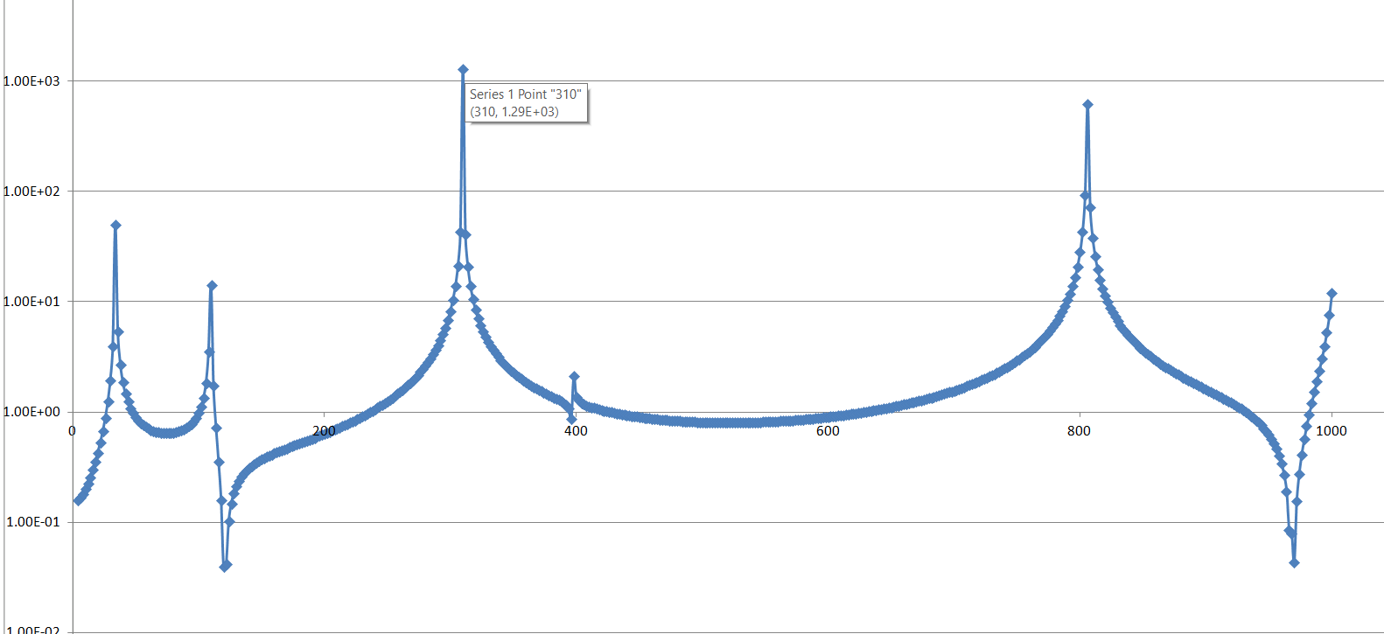
Meta-Beam with inserts
Frequency (hz) | Amplitude ratio
80 | 74
146 - 152 | 12.2 - 0.0008
336 | 163
412 - 420 | 13.7 - 0.15
804 | 3640
994 | 0.056
With 0 inserts-
Frequency (hz) | Amplitude ratio
34 | 49.8
110 - 120 | 14.1 - 0.04
310 | 1290
396 - 398 | 0.87 - 2.1
806 | 621
970 | 0.0435
With 2 inserts-

Slide 6
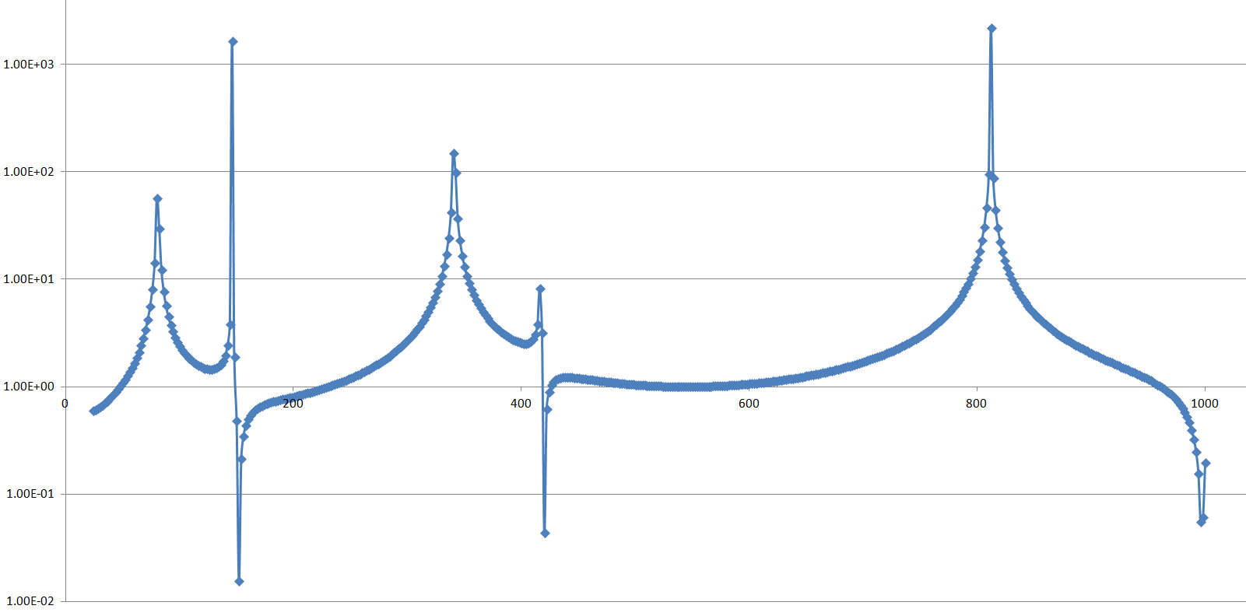
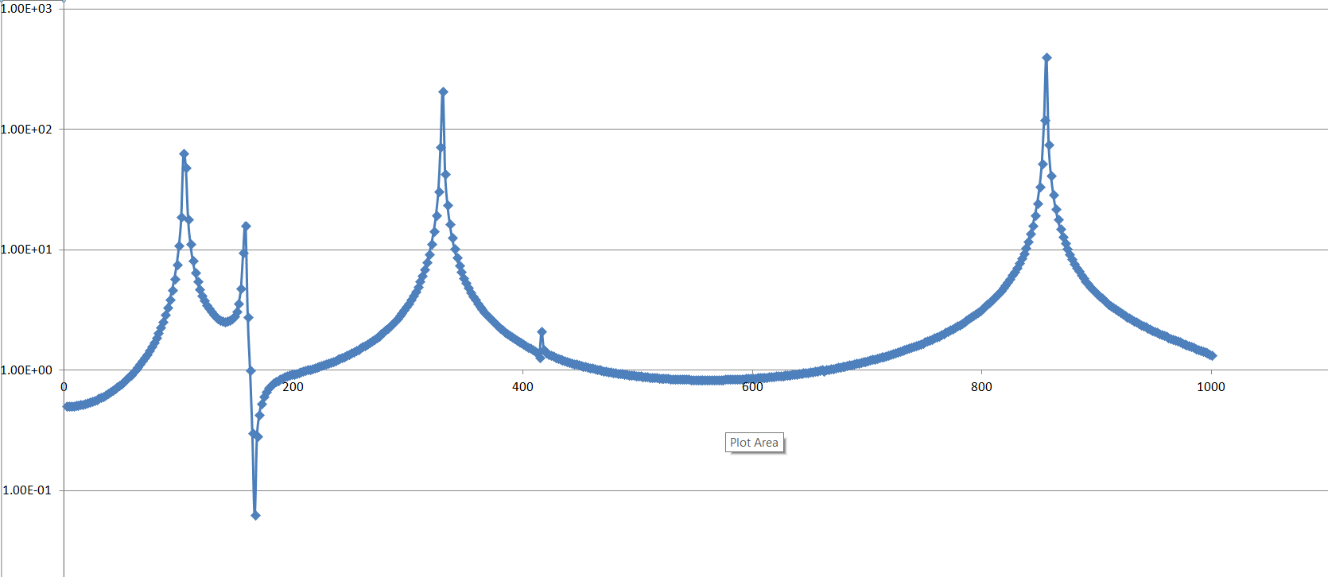
Meta-Beam with inserts
Frequency (hz) | Amplitude ratio
80 | 57
146 - 152 | 1650 - 0.016
340 | 149
416 - 420 | 8.26 - 0.044
812 | 2190
996 | 0.055
With 4 inserts-
Frequency (hz) | Amplitude ratio
104 | 63.6
158 - 166 | 16 - 0.063
330 | 210
412 - 416 | 1.28 - 2.11
856 | 401
With 6 inserts-

Slide 7
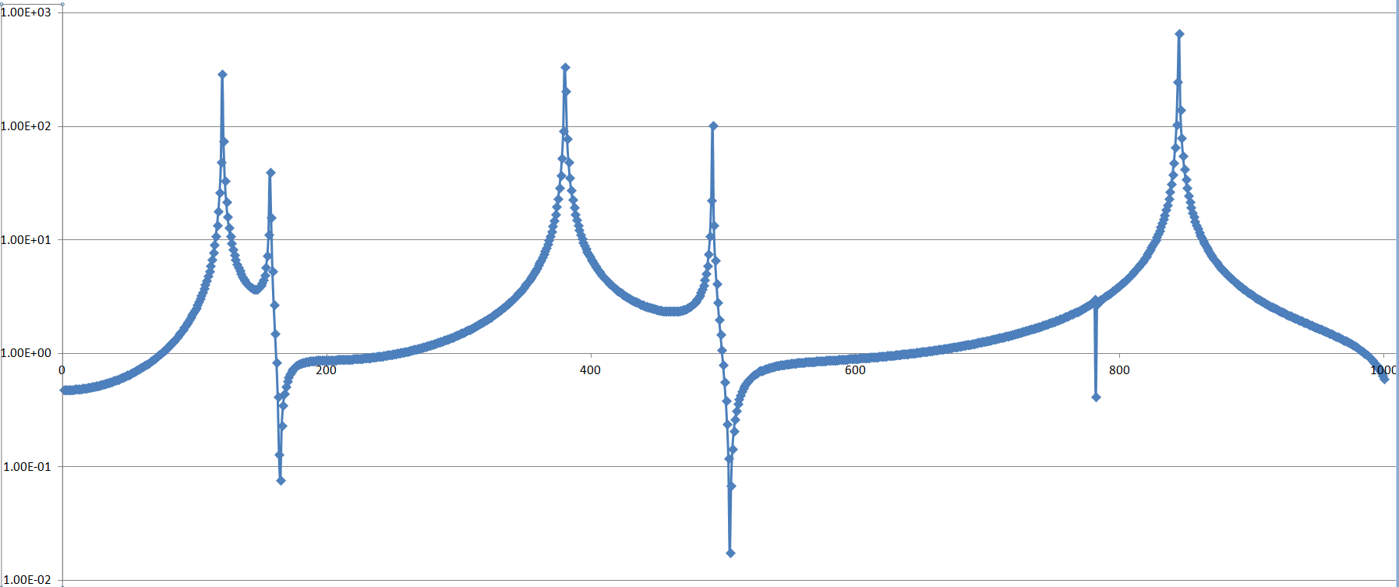
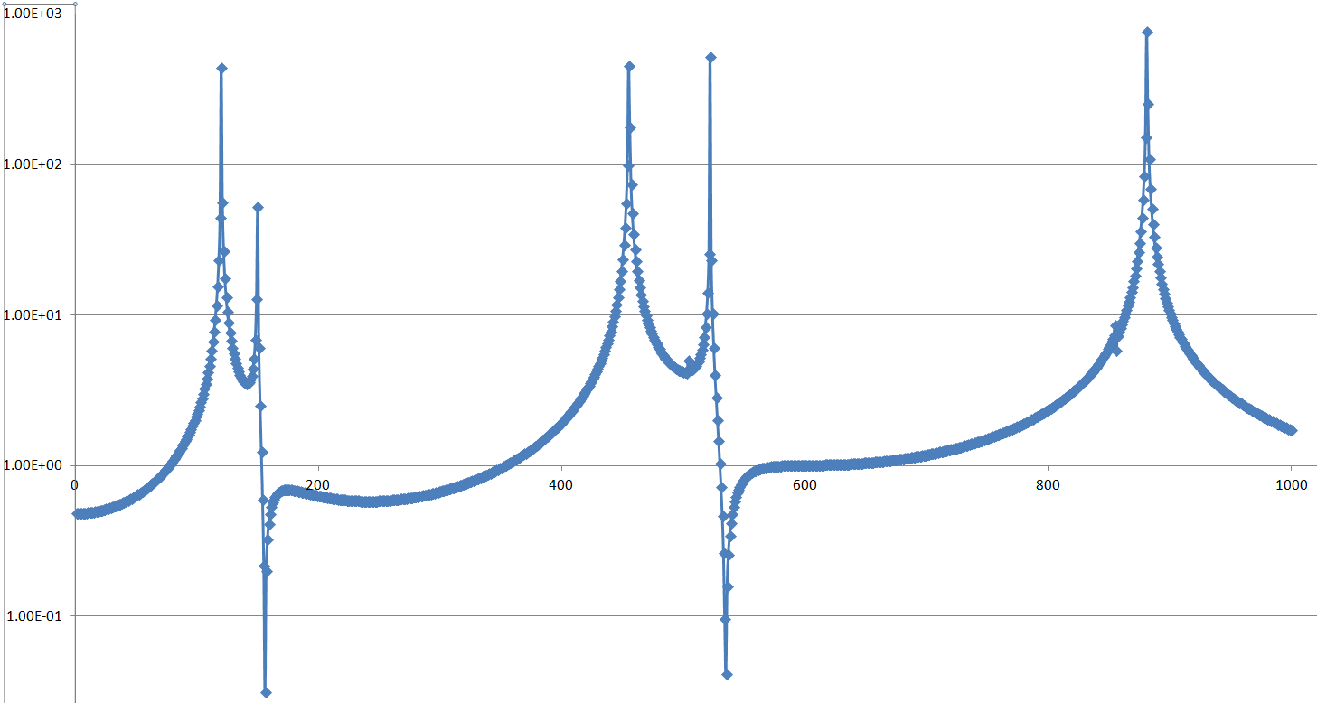
Meta-Beam with inserts
Frequency (hz) | Amplitude ratio
121 | 290
157 - 165 | 39.6 - 0.078
380 | 331
492 - 505 | 102 - 0.017
845 | 658
With 8 inserts
Frequency | Amplitude ratio
120 | 442
150 - 156 | 52.9 - 0.032
455 | 457
522 - 535 | 519 - 0.042
881 | 769
With 10 inserts

Slide 8
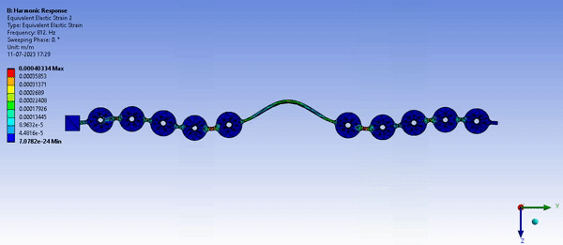
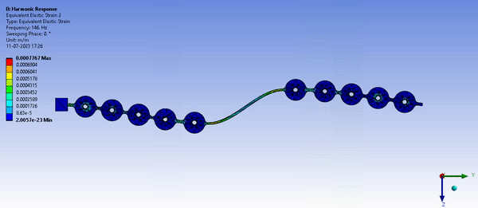
Results from Simulations
Meta-beam with | First mode (hz) | Antisymmetric mode (hz) | Interface mode (hz) | Amplitude ratio for Antisymmetric mode
0 inserts | 80 | 146 | 804 | 12.2
2 inserts | 34 | 110 | 806 | 14.1
4 inserts | 80 | 146 | 812 | 1650
6 inserts | 104 | 158 | 856 | 16
8 inserts | 121 | 157 | 845 | 39.6
10 inserts | 120 | 150 | 881 | 52.9
30% increased cavity length | 47 | 140 | 727 | 55.6

Slide 9
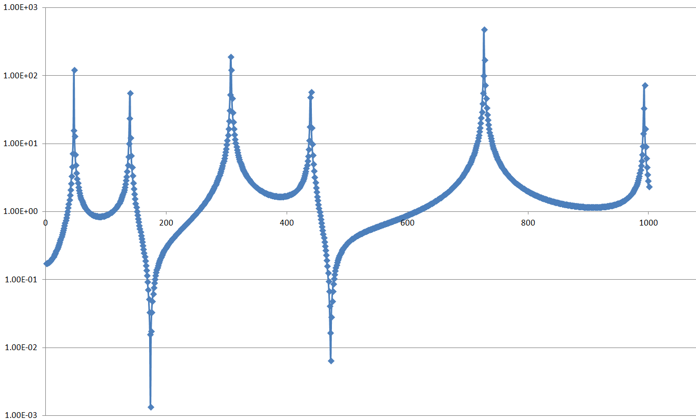
Increasing cavity length of Meta-Beam
Frequency (hz) | Amplitude ratio
80 | 57
146 - 152 | 1650 - 0.016
340 | 149
416 - 420 | 8.26 - 0.044
812 | 2190
996 | 0.055
Meta-material beam with 4 inserts
Cavity length:
42mm
Meta-material beam with 4 inserts
Cavity length:
54.6mm
i.e.
30% increase
Frequency (hz) | Amplitude ratio
47 | 123
140 - 174 | 55.6 - 0.032
307 | 192
459 - 473 | 58 - 0.006
727 | 484
993 | 73

Slide 10
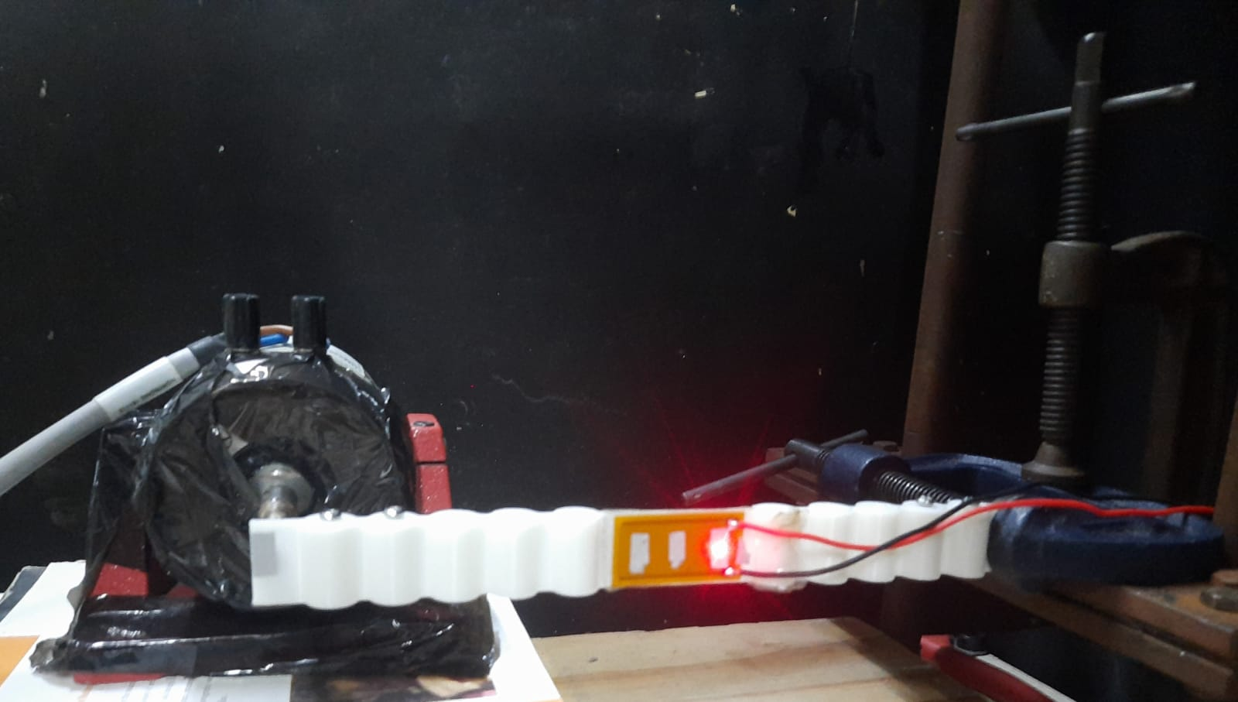
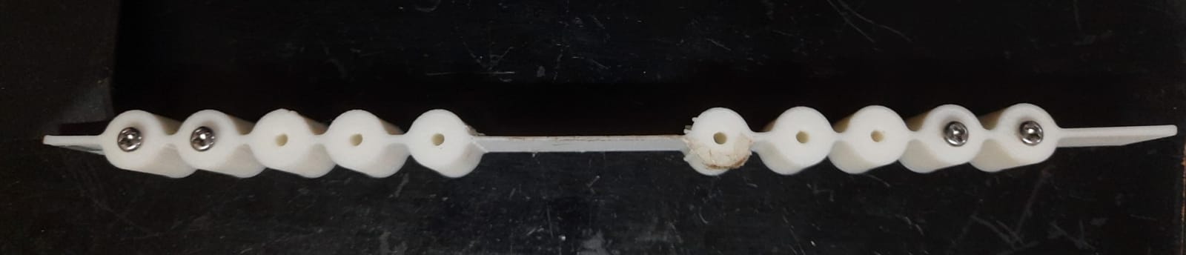
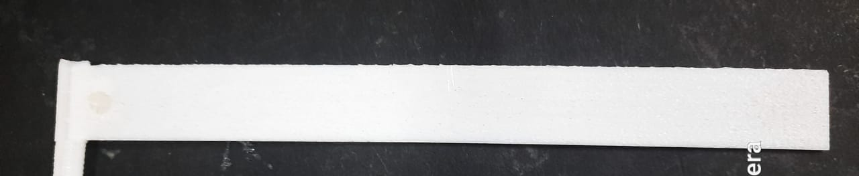
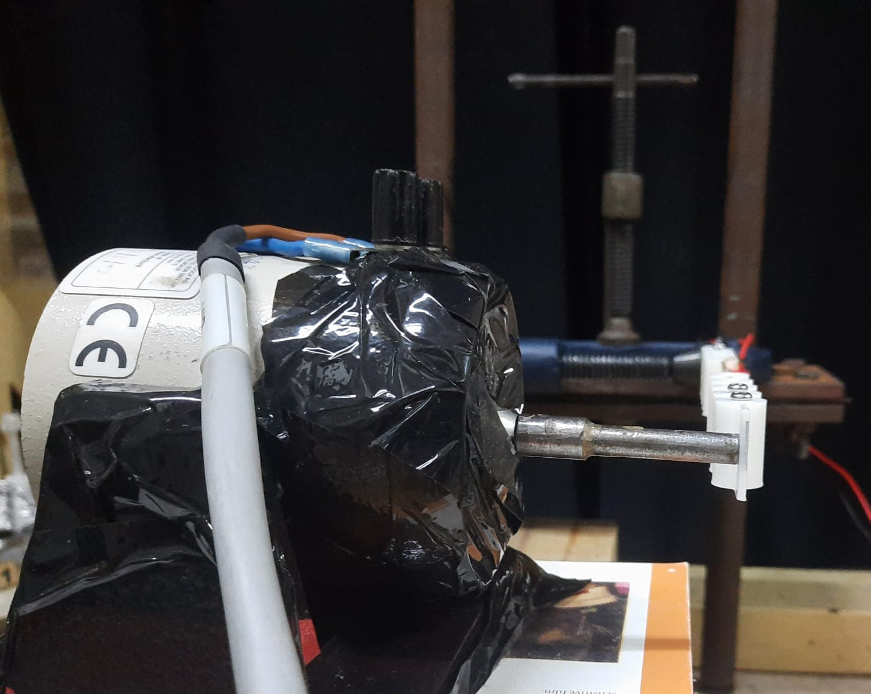
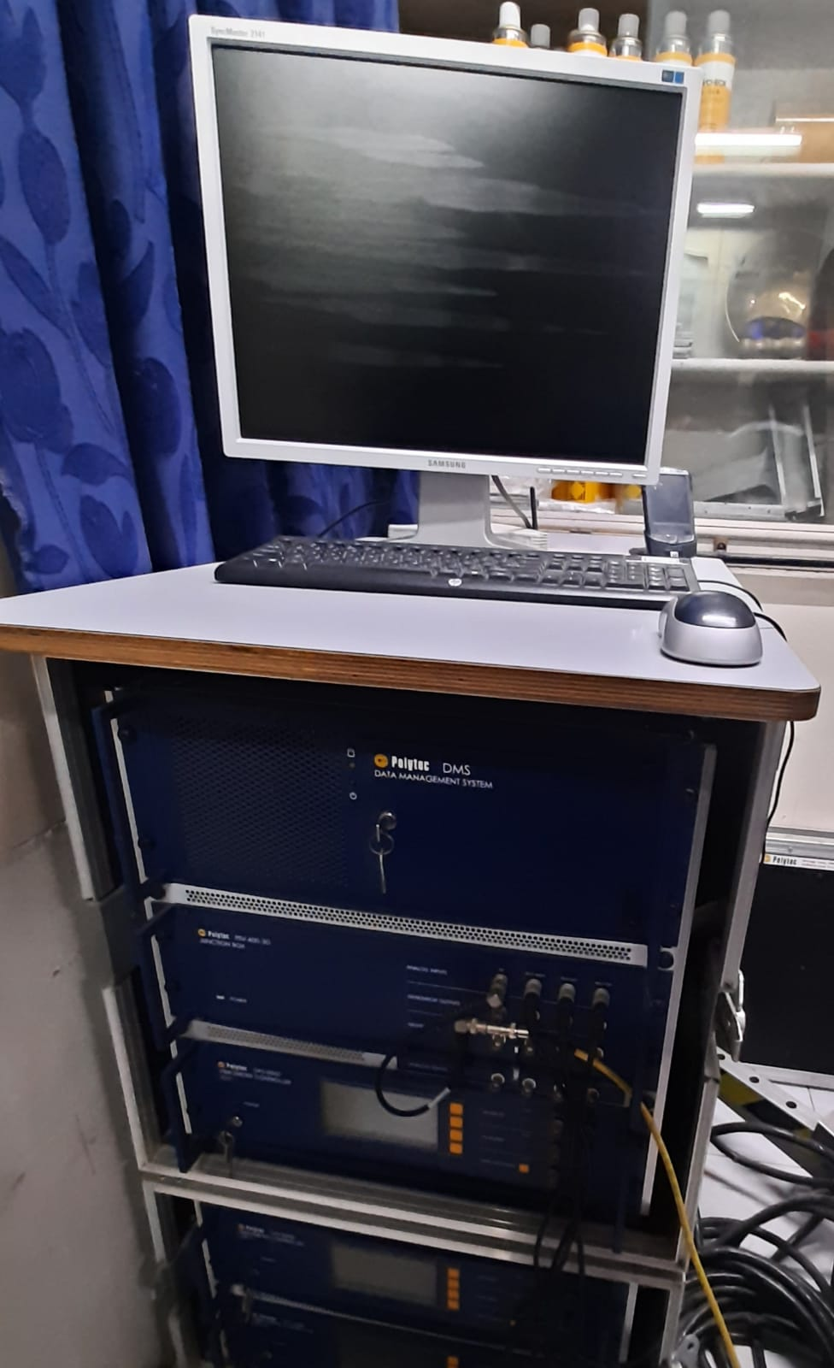
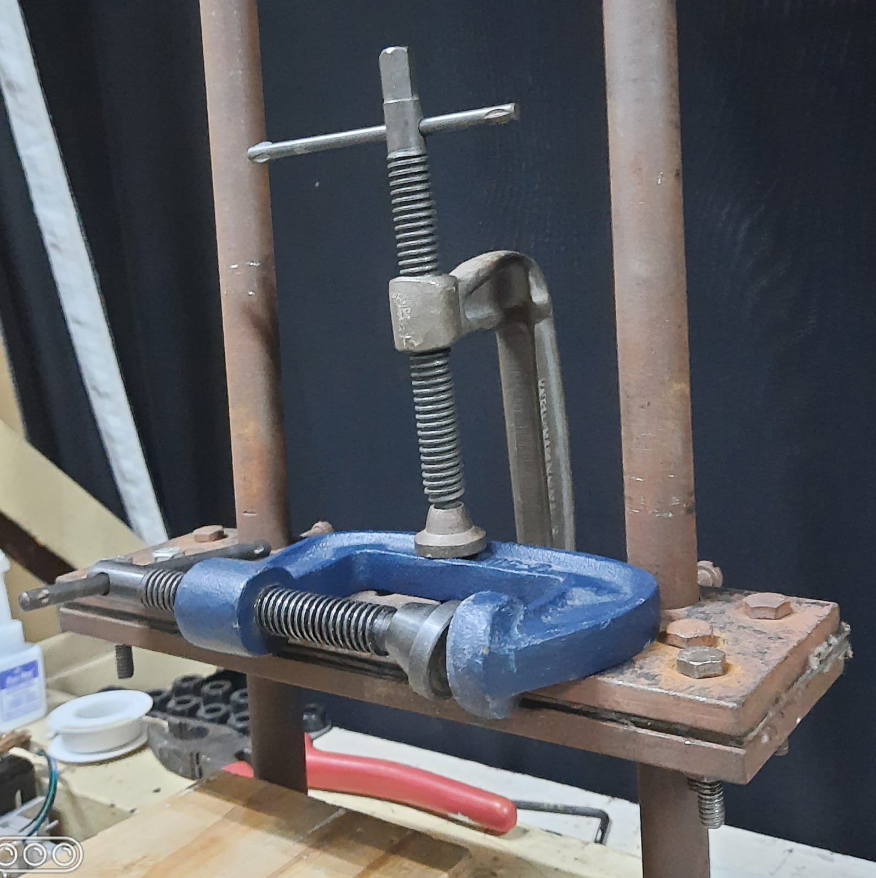
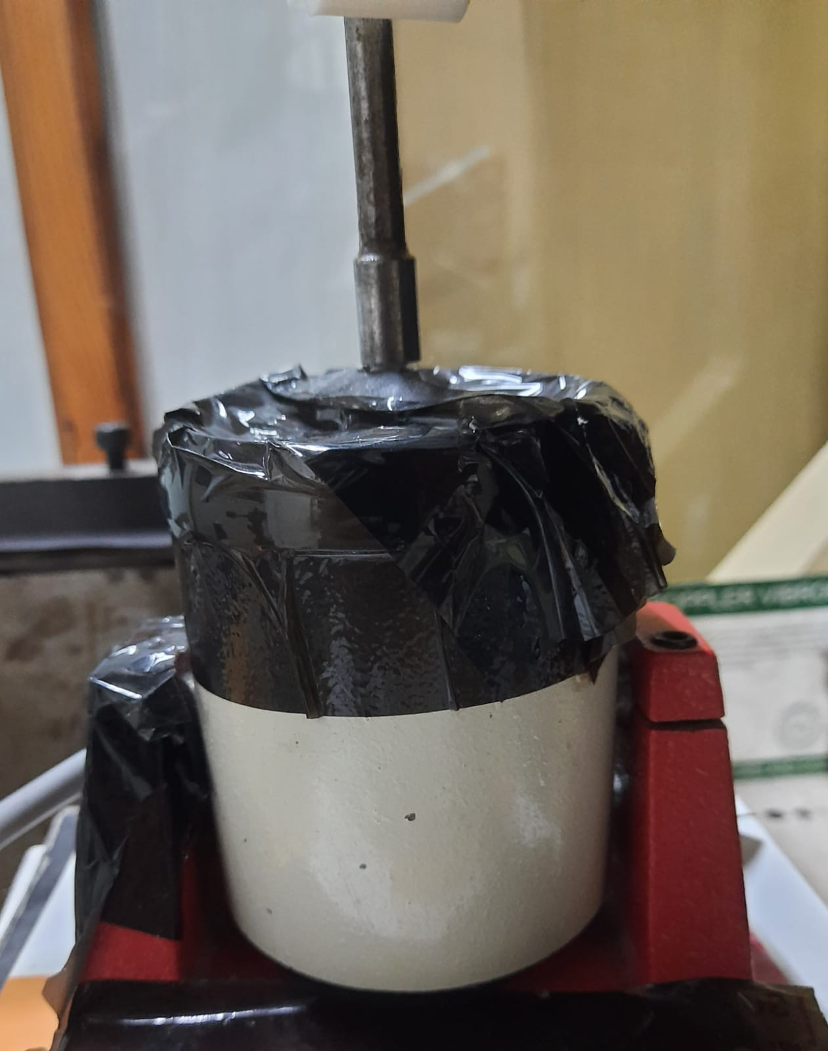
Experimental Set-up
Fig: Meta-material beam
Fig:
Normal beam
Fig: Experiment full set-up
Fig: System
Fig: Clamp
Fig: Shaker

Slide 11
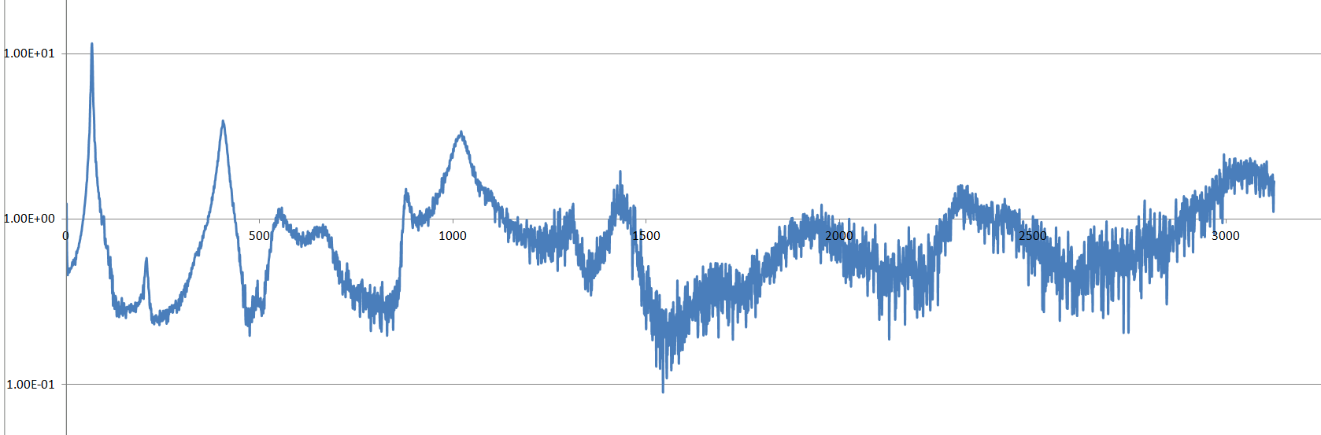
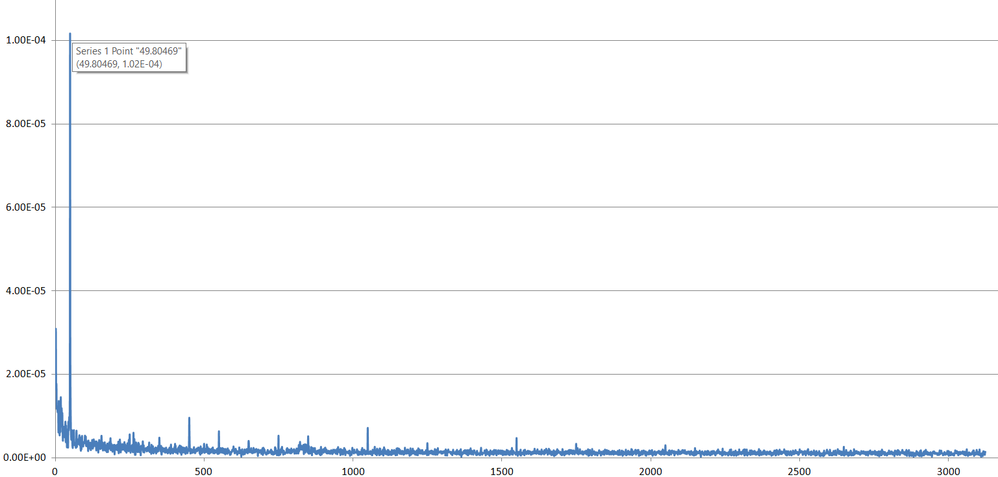
Experiment Results
NORMAL BEAM
Length: 200 mm,
Thickness: 1.8 mm
Frequency (hz) | Amplitude ratio
66.406 | 11.5
405.27 | 3.92
1021 | 3.38
1423 | 1.94
Frequency (hz) | Voltage (micro-V) | Amplitude ratio
49.805 | 102 | 1.35

Slide 12
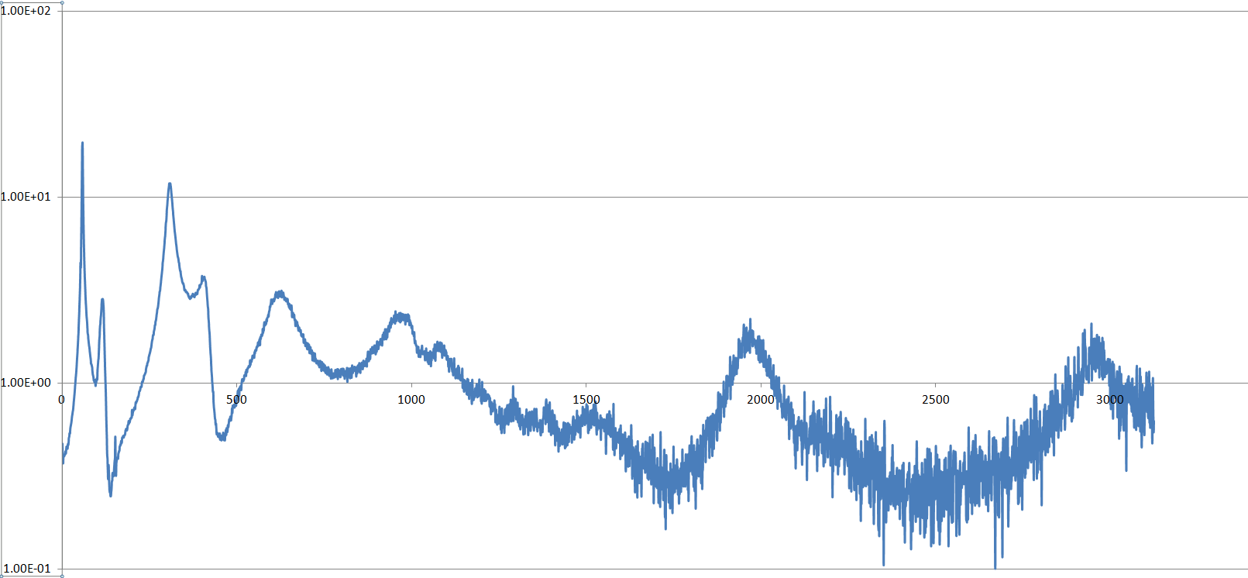
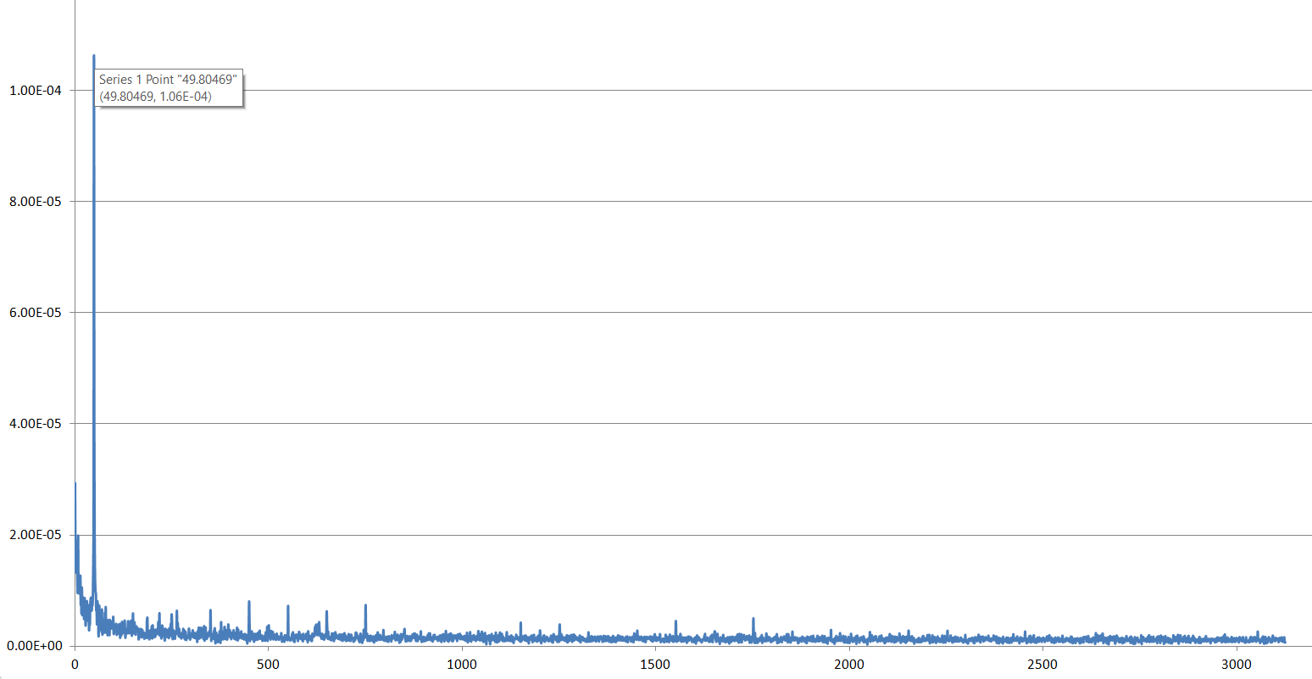
Experiment Results
META-MATERIAL BEAM
Length: 200 mm, Thickness: 1 mm
S. no. | Frequency (hz) | Amplitude ratio
1 | 58.6 | 19.7
2 | 116.2 | 2.85
3 | 309.6 | 11.9
4 | 400.4 | 3.79
5 | 627 | 3.15
6 | 957 | 2.23
7 | 1969 | 2.22
8 | 2964 | 1.64
Frequency (hz) | Voltage peak (micro-V) | Amplitude ratio
49.805 | 102 | 1.35

Slide 13
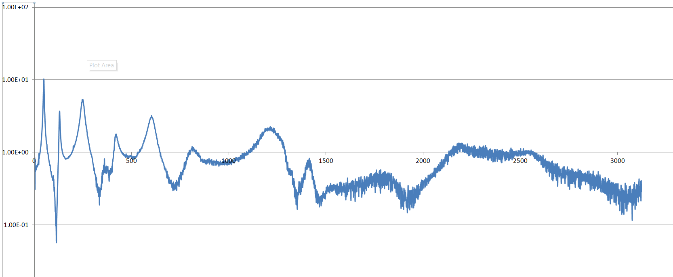
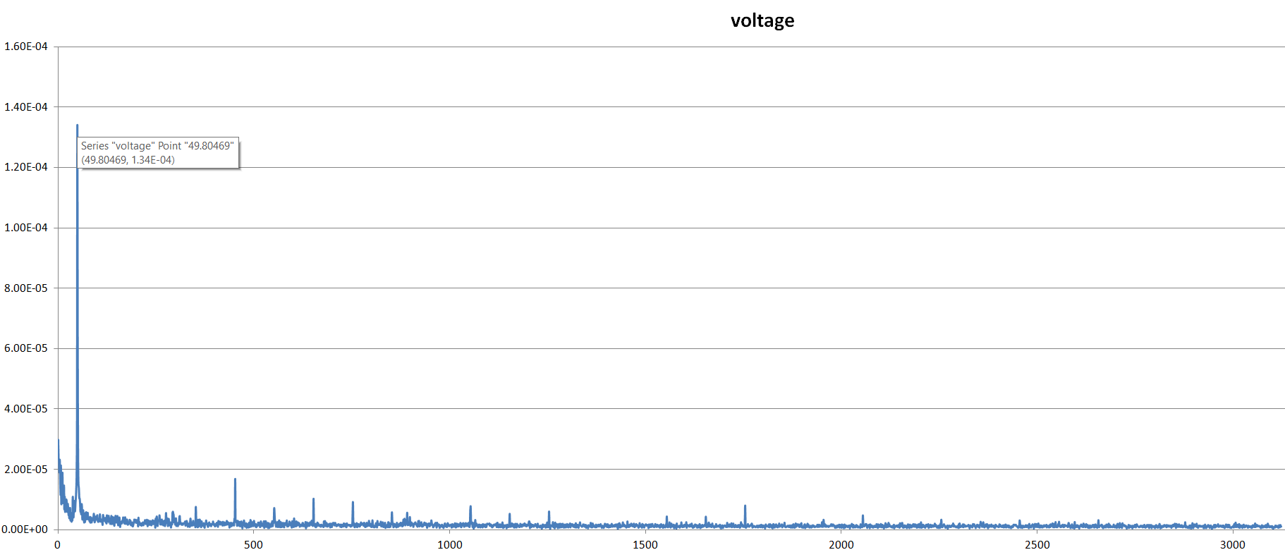
Experiment Results
META-MATERIAL BEAM
Length: 200 mm, Thickness: 2 mm
S. no. | Frequency (hz) | Amplitude ratio
1 | 48.8 | 10.3
2 | 127.9 | 3.12
3 | 245.1 | 4.87
4 | 417.9 | 1.64
5 | 596.7 | 2.96
6 | 810 | 1.11
7 | 1213 | 2.28
Frequency (hz) | Voltage peak (micro-V) | Amplitude ratio
49.805 | 134 | 10.3

Slide 14
Experiment Results Comparison
Beam Configuration | Thickness (mm) | Frequency (hz) | Voltage (micro-V)
Normal Beam | 1.8 | 49.805 | 102
Meta-Beam | 1 | 49.805 | 106
Meta-Beam | 2 | 49.805 | 134

Slide 15
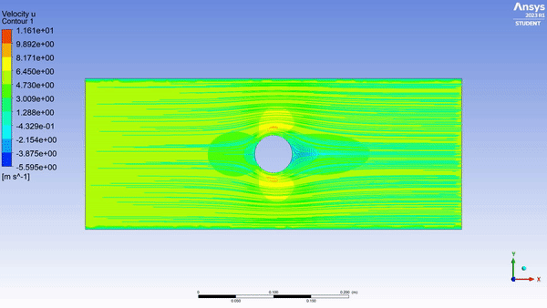
Future Goals
Ansys Fluent:
Different sizes of cylinder were simulated to determine optimum shedding frequency.
The simulation data had inconsistencies in determining shedding frequency, hence are avoided for this PPT.
Once the validation of method of finding shedding frequency is done, all the stored data can be used to get shedding frequency.

Slide 16
References
Park, H. W., Seung, H. M., Choi, W., Kim, M., & Oh, J. H. (2022). Highly tunable low frequency metamaterial cavity for vibration localization. Scientific Reports, 12(1), 1–11. https://doi.org/10.1038/s41598-022-13453-1
Mehdipour, I., Madaro, F., Rizzi, F., & De Vittorio, M. (2022). Comprehensive experimental study on bluff body shapes for vortex-induced vibration piezoelectric energy harvesting mechanisms. Energy Conversion and Management: X, 13. https://doi.org/10.1016/j.ecmx.2021.100174
Wang, J., Sun, S., Tang, L., Hu, G., & Liang, J. (2021). On the use of metasurface for Vortex-Induced vibration suppression or energy harvesting. In Energy Conversion and Management (Vol. 235). https://doi.org/10.1016/j.enconman.2021.113991
Kovalovs, A., Barkanov, E., & Gluhihs, S. (2007). Active control of structures using macro-fiber composite (MFC). Journal of Physics: Conference Series, 93(1). https://doi.org/10.1088/1742-6596/93/1/012034
Wang, J., Sun, S., Tang, L., Hu, G., & Liang, J. (2021). On the use of metasurface for Vortex-Induced vibration suppression or energy harvesting. In Energy Conversion and Management (Vol. 235). https://doi.org/10.1016/j.enconman.2021.113991

Slide 17

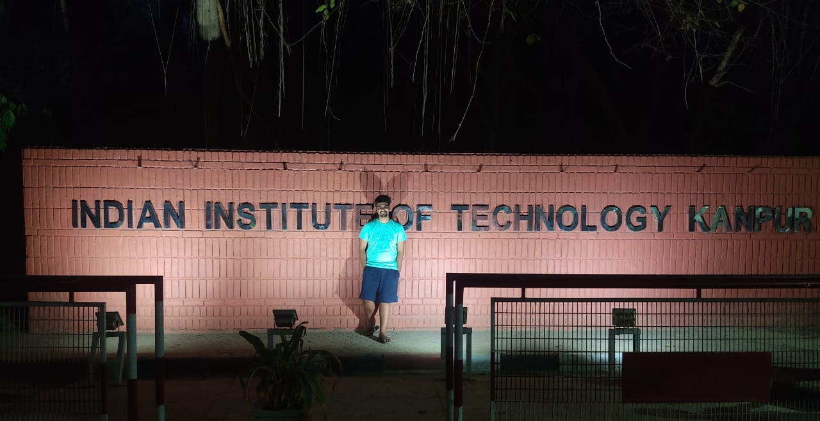



Thank
You!
SMSS
Laboratory
I I T K A N P U R
Prof. Bishakh Bhattacharya
bishakh@iitk.ac.in

